Slide 1

Small Data Learning Analytics for Distance Learning
Richard Treves
@Trevesy
richardtreves.com
November 2017

Slide 2
Introduction
Stories
  1] Kodak
  2] Google
  3] Learning Analytics (web and learning)
Three ‘Small Data’ examples:
  1] Flipped learning at Southampton
  2] Analytics for Action programme at OU (LTI)
  3] Predictive dropout work at OU (IET)
Advocate its use in Distance Learning

Slide 3
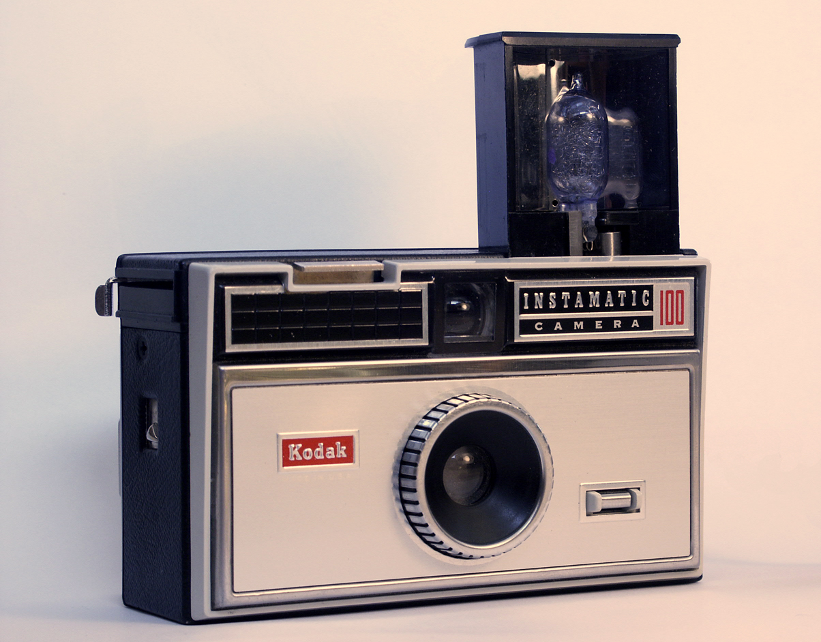
History: 1] Disruptive Innovation
Kodak photography leader
Invented digital camera, no investment
Sees other digital cameras as no threat: cheap, low value
Digital cameras successful, ‘climb’ value chain
Kodak files for bankruptcy

Slide 4

History: 2] Web Analytics
Neat little search trick
  Analyse who points to who 4 search
Google learns who you are
  Google Ads targeted
Learns from ‘big data’
  Shop, surf, go (GPS)?
  Enormous quantity of data (shop, surf)
  Diverse sources
  Hugely successful

Slide 5
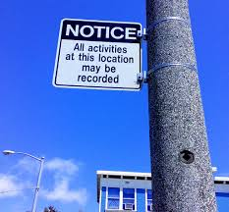
History: 3] Learning Analytics
Big data applied to education
Track student’s interactions
Dropouts=targets
      USA and Open University
Huge potential to improve distance learning

Slide 6
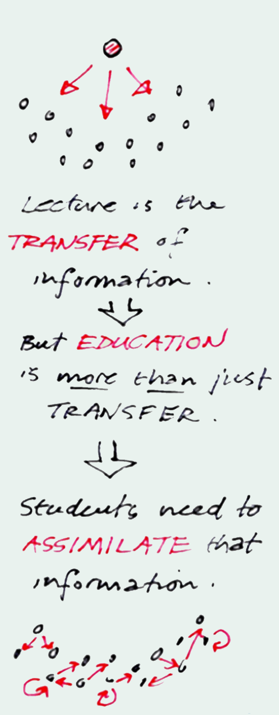
Flipped Learning: Introduction
“Design Skills Maps and Presentations”
  2012 to 2015
Unhappy with students’ learning in class
Theory delivered out of class:
  Videos, quizzes, readings, forums etc.
  Distance?
Practise in class, F2F
  The Zombie app: find route home avoiding zombies
  Real time web conference (Adobe Connect)?
  Very positive feedback
  David Read’s work Simon Lancaster (talk)
Poster on Flipped Learning via Prezi and Video at
http://googleearthdesign.blogspot.co.uk/2014/07/so-there-is-celebration-going-on-in.html

Slide 7
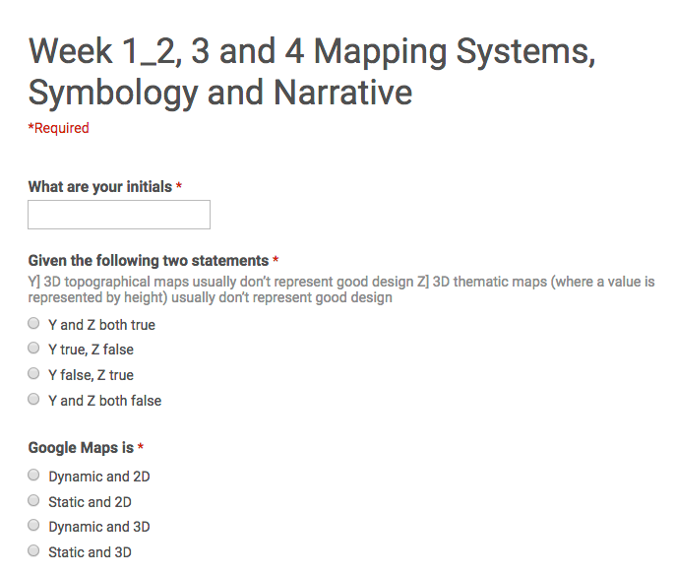
Flipped Learning Small Data LA
ALT-C Attention!
Will Students do prep work?
Set up Google Form for each week
MCQs or Open answers (1/2 paragraph)
  MCQs for videos
  At least one open question per reading
  ‘Any problems you’d like me to address?’ question
Scan read Qs for group problems
Tracked ‘no show’ students
  emailed - +ve response!
80% students up to date weeks 0-3!

Slide 8
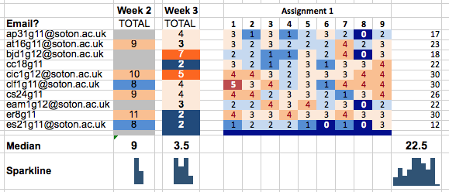
Small Data Dashboard Dream
Dashboard sketch, tutors
Represents Small Data
  Formative quiz out of class
  Criteria of assignments
  Other ‘content’ driven
Prediction Project at Open Uni.
No A.I. but highly effective?
  Explore before going complex

Slide 9
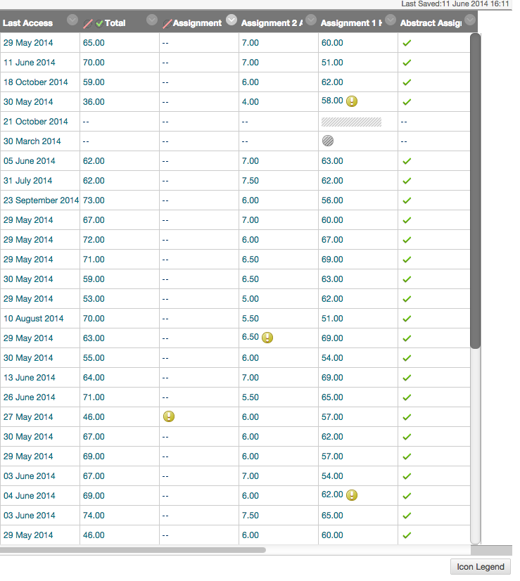
BB Learn Analytics
Ugh!

Slide 10
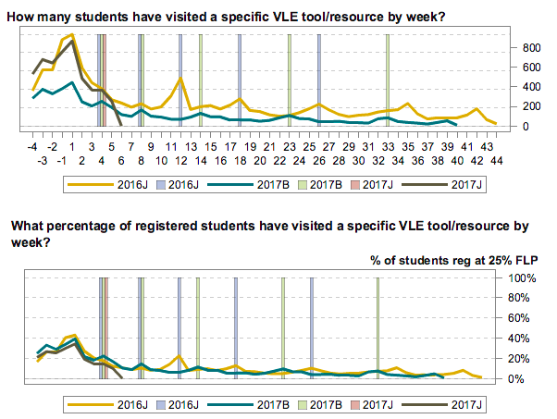
Open Uni. A4A (Action 4 analytics)
Learning Analytics by Module
Anonomised
  Accessible by all OU staff
  Addresses retention issues
  e.g. ‘Intro forum’ use

Slide 11
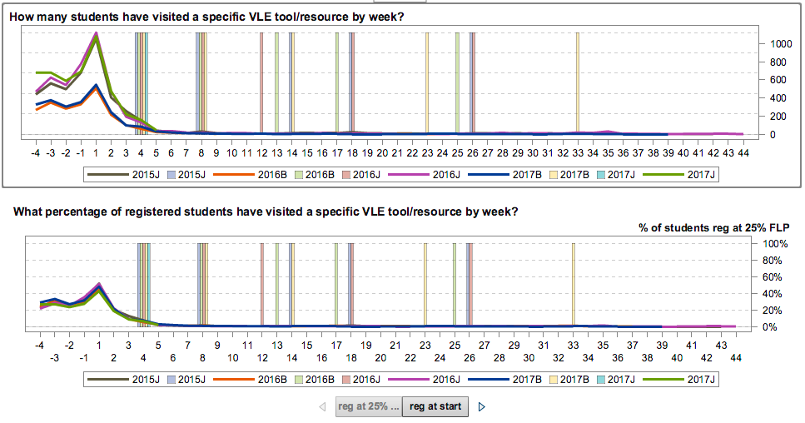
A4A II Tracking Tool/Content
e.g. Introduction to module
Not watching Videos example

Slide 12
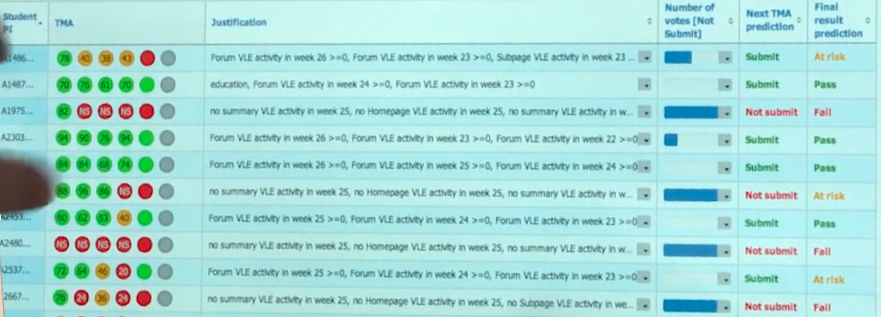
Predictive Modelling IET
See FT News Story and IET LA page

Slide 13
Synthesis
History
SD Small Data
OU Use SD?

Slide 14
Conclusion
I used Small Data on my maps module to support: individual students; the student group and inform my practice.
Small data system can be ‘hacked’ – its simple! Here now!
Small Data LA proving very popular amongst OU academics (other colleagues)

