Slide 1
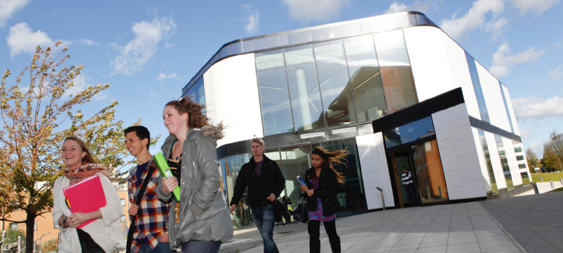


Office Mix Introduction – What is a screencast?
Richard Treves, Educational Technologist
@Trevesy
www.RichardTreves.com

Slide 2
Introduction
What is a screencast?
Tutors recording a screencast
Flipped Learning
Other uses

Slide 3
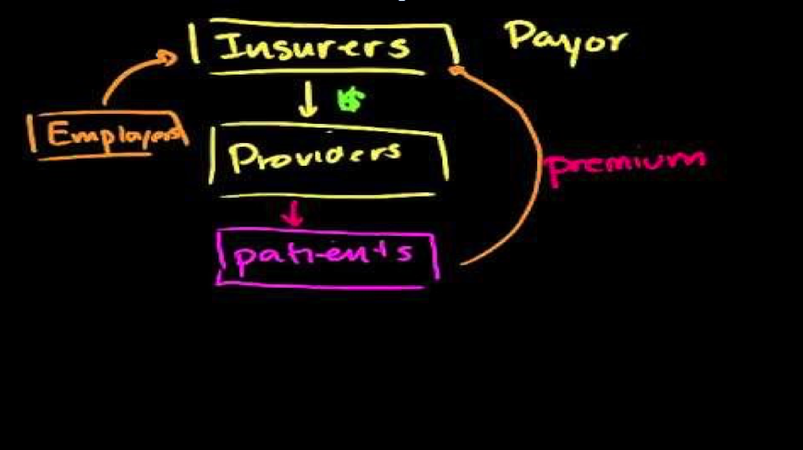
What is a Screencast?
Recording of the screen with audio
  No talking head, no ‘natural’ video
  Mayer and Moreno (2003)
Mayer, Richard E., and Roxana Moreno. "Animation as an aid to multimedia learning." Educational psychology review 14.1 (2002): 87-99.

Slide 4
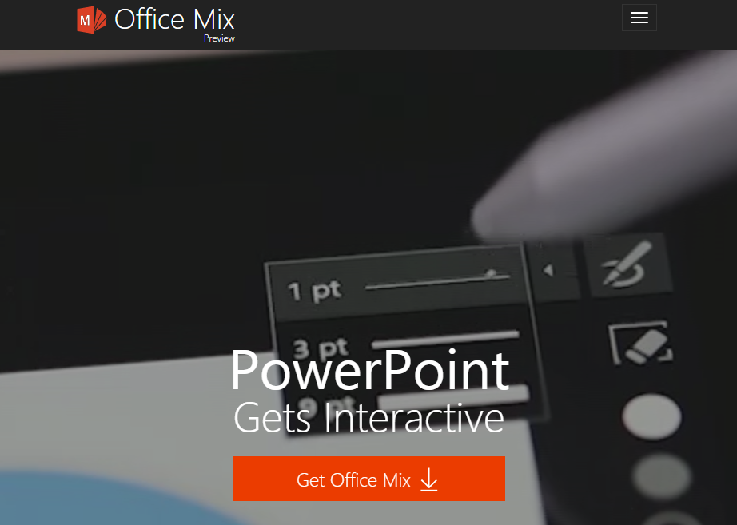
Animated Slide and Mind Map
Office MIX add on to PowerPoint
Functions:
  Record PowerPoint (including inking)
  Record screen (e.g. explain online questionnaire)
  Add self assessment question
No timeline to use = Good Usability
Tutors/students already using PPT

Slide 5

Case Study 1: Tutors flipping learning
Create online lectures
Students get ‘theory’ out of class
Practise in class

Slide 6
Other suggested uses
Screencast of marking feedback
  Warmth, detail
Reuse slides in other lectures
Record a talk version of a poster

Slide 7
Conclusion
Technical barriers to recording screencasts gone
Screencasts useful digital capability for tutors
My favourite opportunity:
  Flipped learning

Slide 8
Students and Tutors Creating Screencasts
Richard Treves, Educational Technologist
@Trevesy
www.RichardTreves.com

